Slide 1

Parallel Programming Using Pthread
First Project Presentation for
CS 8172 –Parallel-Distributed Computing-Fall 2025
Md Jahirul Islam
001120708
Kennesaw State University
Course Instructor
Dr. Bobin Deng

Slide 2
Presentation Outline
Introduction 3
Methodology & Experimental setup 6
Result analysis 8
Conclusion 12

Slide 3
Introduction (Problem Description)
Substring matching Using parallel multiprogramming
#_of_substring(“abcdab”, “ab”) = 2,
#_of _substring(“aaa”, “a”) = 3,
#_of _substring(“abac”, “bc”) = 0.

Slide 4
Introduction
What is Pthread, Sequential and Parallel programming
Sequential programming: instructions are executed one after another in a linear way. A single thread of control handles all tasks
Parallel Computation: execute multiple tasks or parts of a single task simultaneously using multiprocessing and or multithreading
Pthread: multithreading programming API in C

Slide 5
Introduction
Sequential vs Parallel threading
Task
Task
Sub task 1
Sub task 2
Sub task 3
Thread 1
Thread 1
Thread 2
Thread 3
Compute
Compute
Compute
Compute

Slide 6
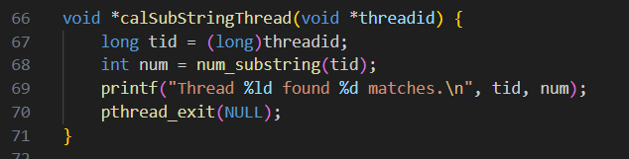
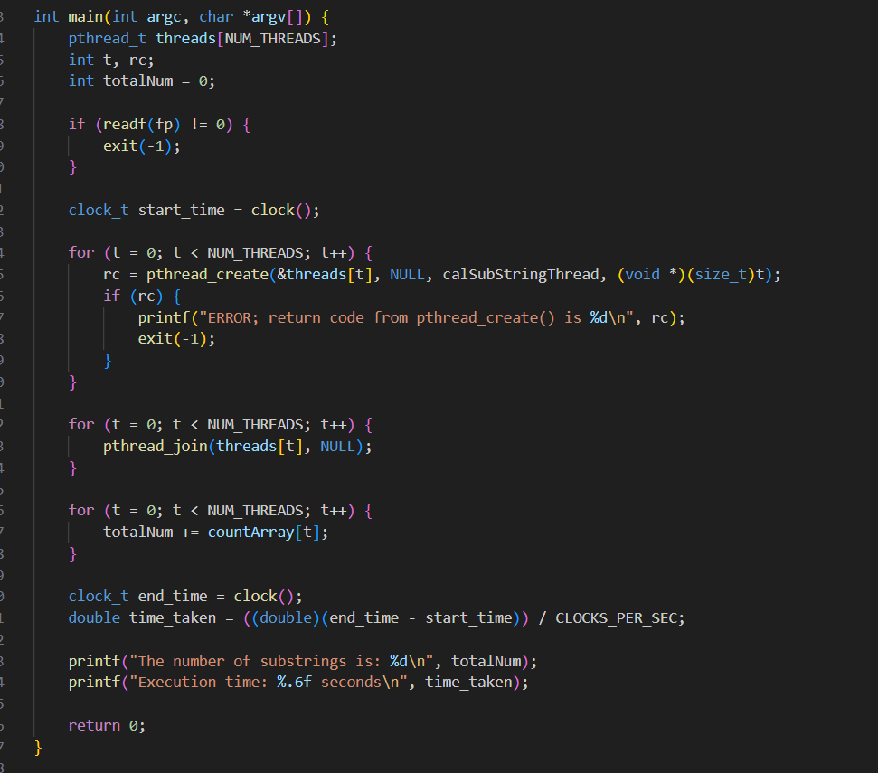
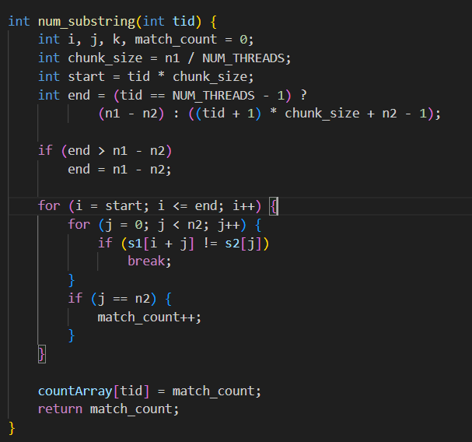
Methodology
Parallel programming Code explanation

Slide 7
Experimental setup
Two types of solution Parallel and Sequential
Three strings of different weights
String.txt | Size
Small | 5 KB
Large | 34,475 KB
Very Large | 68,950 KB

Slide 8
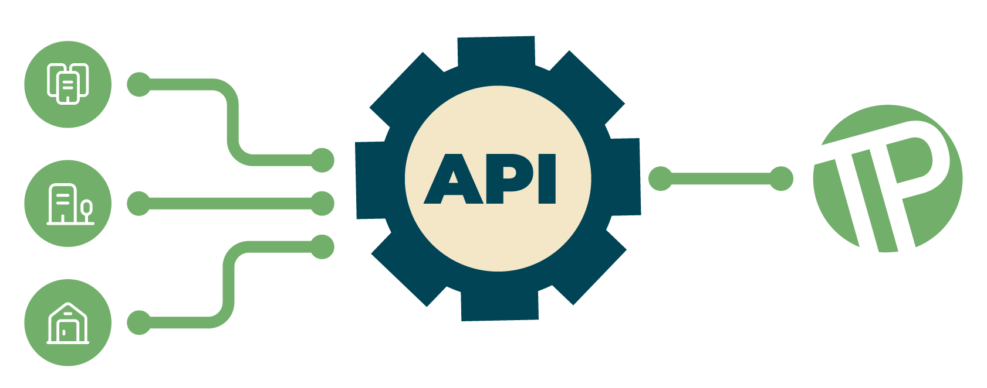
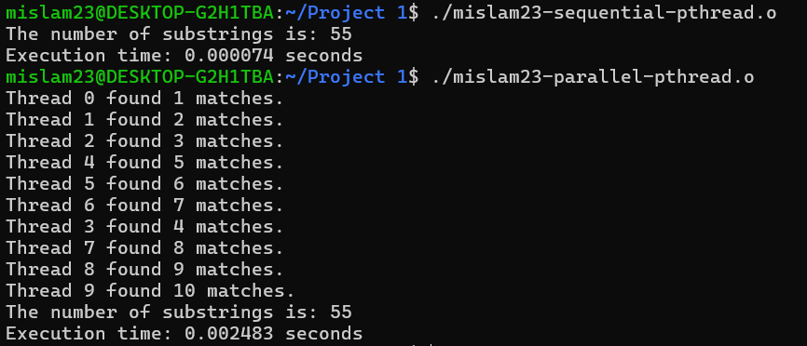
Results and findings
Run on small string
Parallel computation time > Sequential computation time
Thread creation cost
8

Slide 9
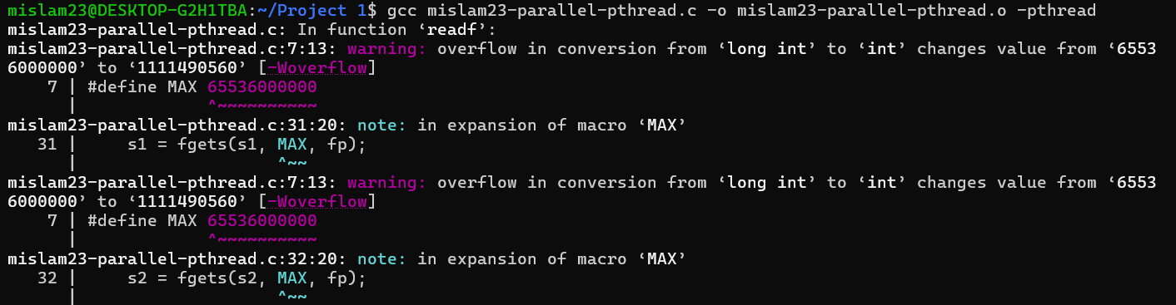

Results and findings
Memory overflow
Increased the size of allocated memory (string buffer)
9

Slide 10
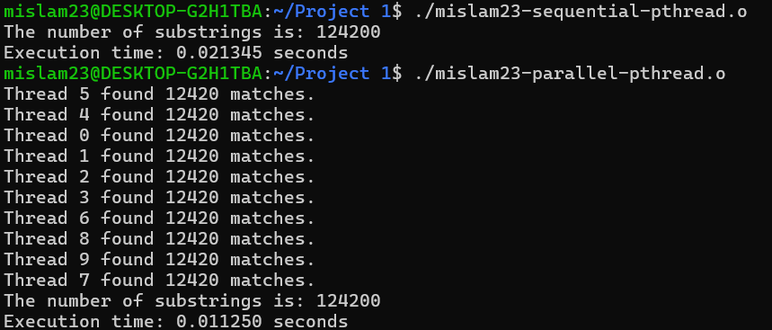
Results and findings
Run on large string
Parallel computation time < Sequential computation time
10

Slide 11
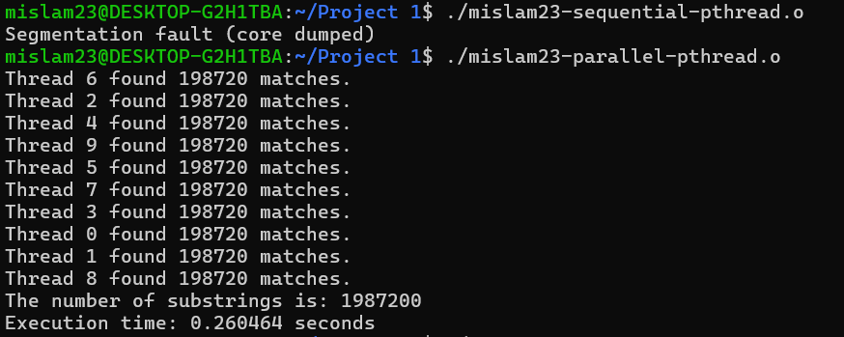
Results and findings
Run on Very large string
Sequential computation failed but parallel computation persists
11

Slide 12
Conclusion
Table 1: Result analysis
String.txt | Size | # of matches | Serial (time) | Parallel (time)
Small | 5 KB | 55 | 0.000074 | 0.002483
Large | 34,475 KB | 124200 | 0.021345 | 0.011250
Very Large | 68,950 KB | 1987200 | Failed | 0.260464
Sequential programming is easier and faster for small data
Parallel programming is complex but faster for large data

Slide 13

Discussion
Thank you so much….
13

